Slide 1
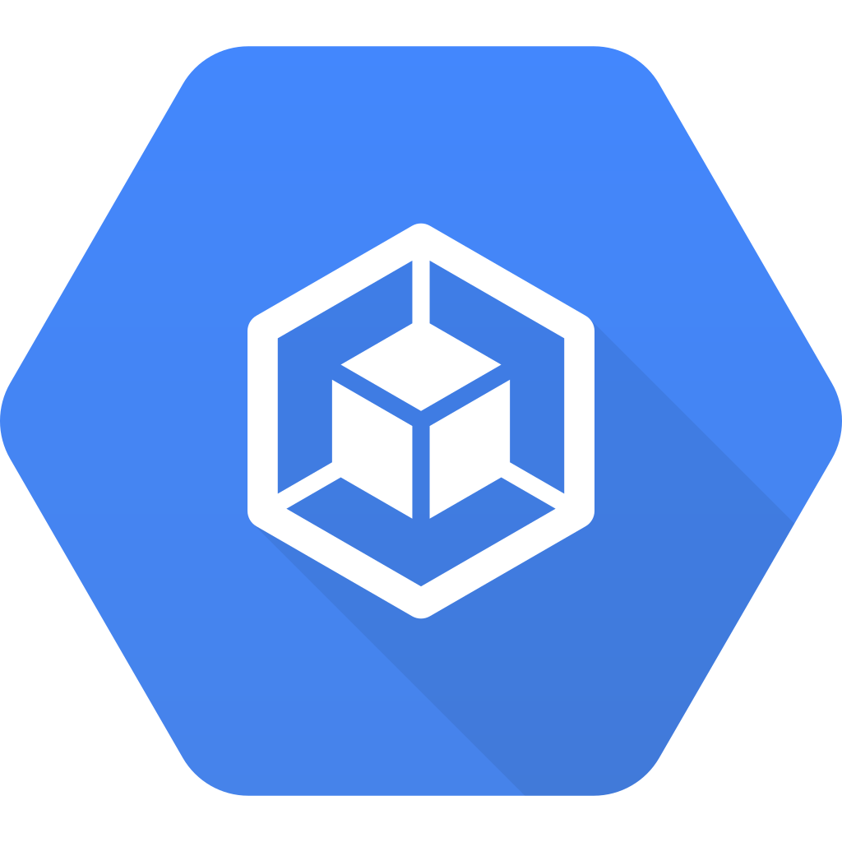
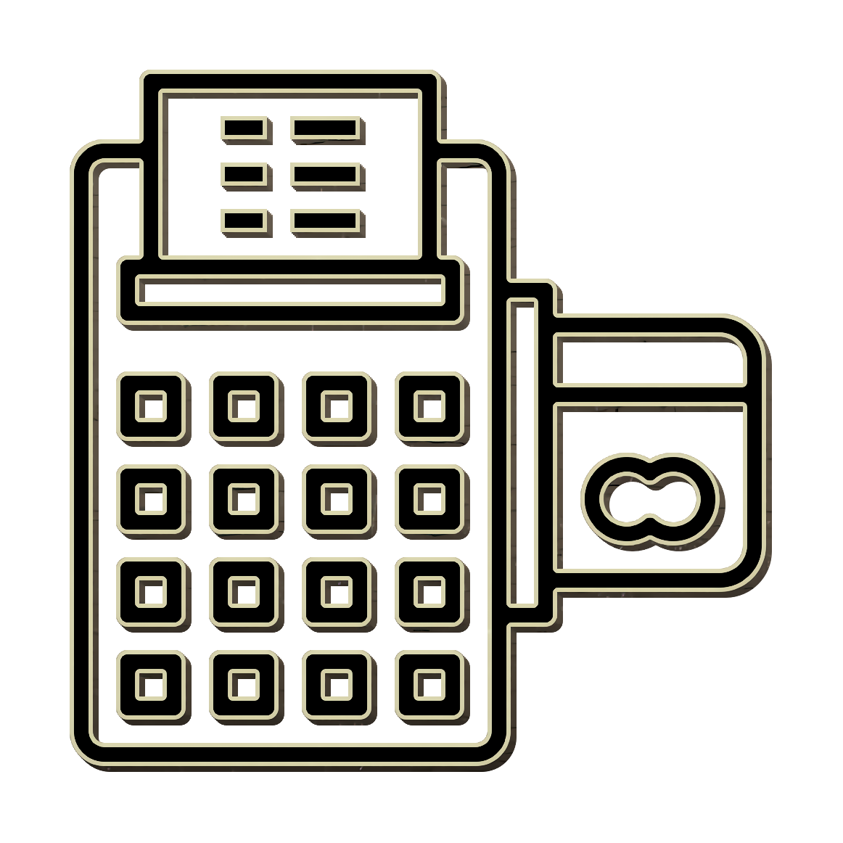


Kubernetes only environment
Kubernetes Cluster
Frontend
Machine
Stocks
Human
Login
Database
Stock Transaction
Users

Slide 2
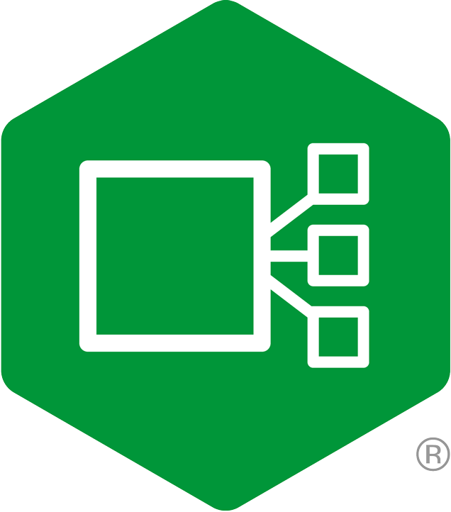
Application published with Nginx Ingress
Kubernetes Cluster
Frontend
Machine
Stocks
Human
Login
Database
Ingress
Stock Transaction
Open ID Connect
Users
ELK

Slide 3
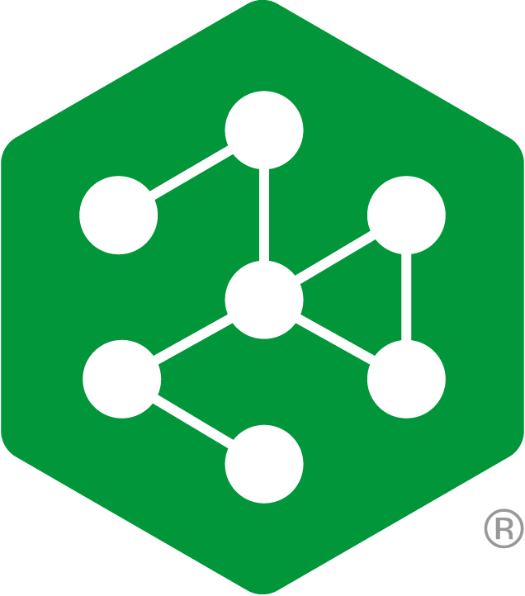

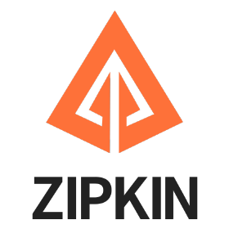
Nginx Service Mesh adds visibility within the app flows
Kubernetes Cluster
Frontend
Machine
Stocks
Human
Login
Database
Ingress
Stock Transaction
Open ID Connect
Users

Slide 4
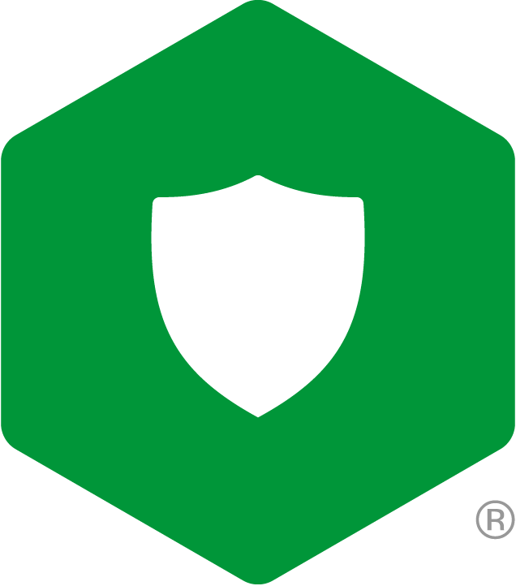

Protect the application with Nginx App Protect
Kubernetes Cluster
Frontend
Machine
Stocks
Human
App Protect
Login
Database
Ingress
Stock Transaction
Open ID Connect
Users
ELK

Slide 5

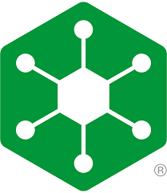
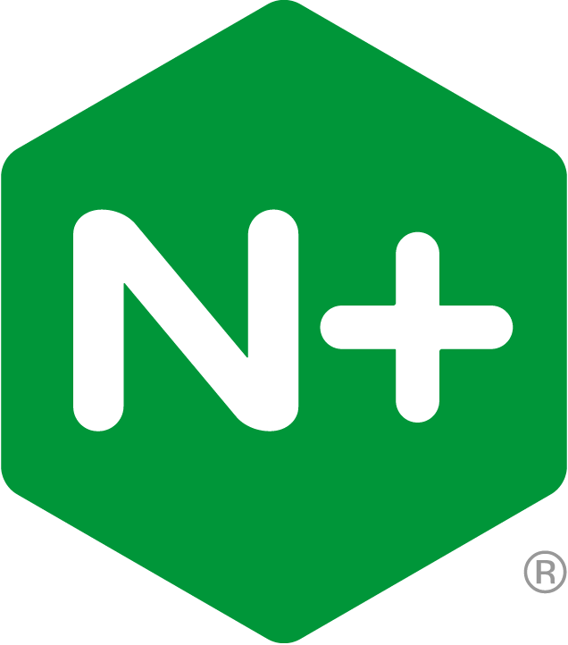
Publish application APIs
Kubernetes Cluster
{ API }
Nginx Controller
Frontend
Machine
App Protect
Stocks
API Gateway
Human
App Protect
Login
Database
Ingress
Stock Transaction
Open ID Connect
Users
ELK

Slide 6
Kubernetes Cluster
{ API }
Nginx Controller
Frontend
Machine
App Protect
Stocks
API Gateway
Human
App Protect
Login
Database
Ingress
Stock Transaction
Open ID Connect
Users
ELK

